Slide 1


Yashaswini D
29th December 2024

Slide 2

Outline
Executive Summary
Introduction
Methodology
Results
Conclusion
Appendix

Slide 3
Executive Summary
Summary of methodologies
Data Collection through API
Data Collection with Web Scraping
Data Wrangling
Exploratory Data Analysis with SQL
Exploratory Data Analysis with Data Visualization
Interactive Visual Analytics with Folium
Machine Learning Prediction
Summary of all results
Exploratory Data Analysis result
Interactive analytics in screenshots
Predictive Analytics result

Slide 4
Introduction
Project background and context
SpaceX has transformed the space industry by dramatically reducing the cost of rocket launches. The Falcon 9, priced at $62 million, is significantly more affordable than competitors' rockets, which typically cost upwards of $165 million. This cost advantage is largely due to SpaceX’s innovative approach of reusing the first stage of the rocket, which is successfully landed and repurposed for future missions. By reusing the first stage, SpaceX continues to reduce launch costs over time.
As a data scientist at a startup aiming to compete with SpaceX, the goal of this project is to develop a machine learning pipeline that predicts the success of the first stage landing. This prediction will help determine launch costs and enable competing companies to strategically bid against SpaceX.
Problems you want to find answers
What factors influence the successful landing of the rocket’s first stage?
How do variables such as payload mass, launch site, number of flights, and orbits impact the landing success?
What operational conditions maximize the likelihood of a successful landing?
How has the success rate of first-stage landings evolved over the years?
What is the most effective machine learning algorithm for predicting landing success in this binary classification task?

Slide 5

Section 1

Slide 6
Methodology
Executive Summary
Data collection methodology:
Data was collected using SpaceX API and web scraping from Wikipedia.
Perform data wrangling
One-hot encoding was applied to categorical features
Perform exploratory data analysis (EDA) using visualization and SQL
Perform interactive visual analytics using Folium and Plotly Dash
Perform predictive analysis using classification models
How to build, tune, evaluate classification models

Slide 7
Data Collection
The data for this project was collected using two methods: REST API and web scraping. These approaches enabled the extraction of relevant data for analysis and decision-making.
REST API:
Using the SpaceX API, data was gathered by sending GET requests. The response was decoded into JSON format using the .json() function and converted into a pandas dataframe with the json_normalize() method. The dataset was then cleaned, checked for missing values, and appropriately filled to ensure completeness.
Web Scraping:
Falcon 9 launch records were extracted from Wikipedia using BeautifulSoup. The data, retrieved as HTML tables, was parsed and transformed into pandas dataframes for further analysis.

Slide 8
Data Collection – SpaceX API
We used the get request to the SpaceX API to collect data, clean the requested data and did some basic data wrangling and formatting.
GitHub URL: https://github.com/yash2412-d/IBM-Data-Science/blob/main/Applied%20Data%20Science%20Capstone/Week%201/jupyter-labs-spacex-data-collection-api.ipynb
Get request for rocket launch data using API
Use json_normalize method to convert json result to dataframe
Performed data cleaning and filling the missing value

Slide 9
Data Collection - Scraping
We applied web scrapping to webscrap Falcon 9 launch records with BeautifulSoup
We parsed the table and converted it into a pandas dataframe.
GitHub URL: https://github.com/yash2412-d/IBM-Data-Science/blob/main/Applied%20Data%20Science%20Capstone/Week%201/jupyter-labs-webscraping.ipynb
Request the Falcon9 Launch Wiki page from url
Create a BeautifulSoup from the HTML response
Extract all column/variable names from the HTML header

Slide 10
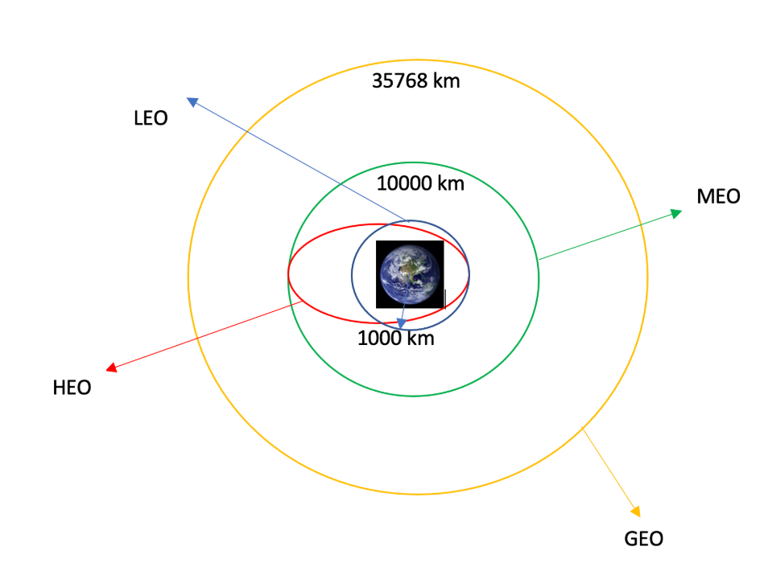
Data Wrangling
Data Wrangling is the process of cleaning and
unifying messy and complex data sets for easy access
and Exploratory Data Analysis (EDA).
We will first calculate the number of launches on each
site, then calculate the number and occurrence of
mission outcome per orbit type.
We then create a landing outcome label from the
outcome column. This will make it easier for further
analysis, visualization, and ML. Lastly, we will export
the result to a CSV.
GitHub URL: https://github.com/yash2412-d/IBM-Data-Science/blob/main/Applied%20Data%20Science%20Capstone/Week%201/labs-jupyter-spacex-Data%20wrangling.ipynb

Slide 11
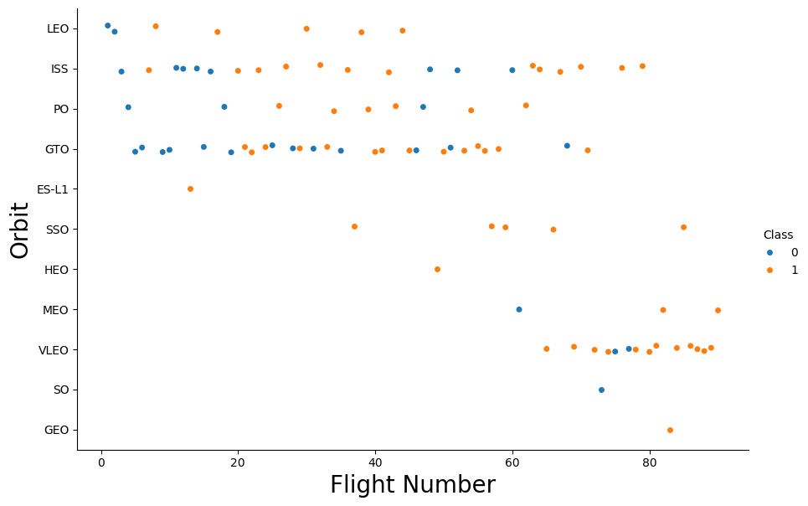
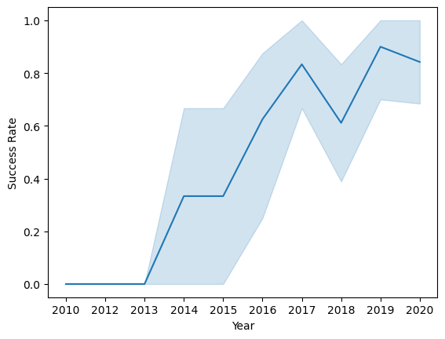
EDA with Data Visualization
Charts were plotted:
Flight Number vs. Payload Mass, Flight Number vs. Launch Site, Payload Mass vs. Launch Site, Orbit Type vs. Success Rate, Flight Number vs. Orbit Type, Payload Mass vs Orbit Type and Success Rate Yearly Trend
Scatter plots show the relationship between variables. If a relationship exists, they could be used in machine learning model.
Bar charts show comparisons among discrete categories. The goal is to show the relationship between the specific categories being compared and a measured value.
Line charts show trends in data over time (time series).
GitHub URL: https://github.com/yash2412-d/IBM-Data-Science/blob/main/Applied%20Data%20Science%20Capstone/Week%202/edadataviz.ipynb

Slide 12
EDA with SQL
Using SQL, we had performed many queries to get better understanding of the dataset, Ex:
Displaying the names of the launch sites.
Displaying 5 records where launch sites begin with the string ‘CCA’.
Displaying the total payload mass carried by booster launched by NASA (CRS).
Displaying the average payload mass carried by booster version F9 v1.1.
Listing the date when the first successful landing outcome in ground pad was achieved.
Listing the names of the boosters which have success in drone ship and have payload mass greater than 4000 but less than 6000.
Listing the total number of successful and failure mission outcomes.
Listing the names of the booster_versions which have carried the maximum payload mass.
Listing the failed landing_outcomes in drone ship, their booster versions, and launch sites names for in year 2015.
Rank the count of landing outcomes or success between the date 2010-06-04 and 2017-03-20, in descending order.
GitHub URL: https://github.com/yash2412-d/IBM-Data-Science/blob/main/Applied%20Data%20Science%20Capstone/Week%202/jupyter-labs-eda-sql-coursera_sqllite.ipynb

Slide 13
Build an Interactive Map with Folium
Markers of all Launch Sites:
Added Marker with Circle, Popup Label and Text Label of NASA Johnson Space Center using its latitude and longitude coordinates as a start location.
Added Markers with Circle, Popup Label and Text Label of all Launch Sites using their latitude and longitude coordinates to show their geographical locations and proximity to Equator and coasts.
Colored Markers of the launch outcomes for each Launch Site:
Added colored Markers of success (Green) and failed (Red) launches using Marker Cluster to identify which launch sites have relatively high success rates.
Distances between a Launch Site to its proximities:
Added colored Lines to show distances between the Launch Site KSC LC-39A (as an example) and its proximities like Railway, Highway, Coastline and Closest City.
GitHub URL: https://github.com/yash2412-d/IBM-Data-Science/blob/main/Applied%20Data%20Science%20Capstone/Week%203/lab_jupyter_launch_site_location.ipynb

Slide 14
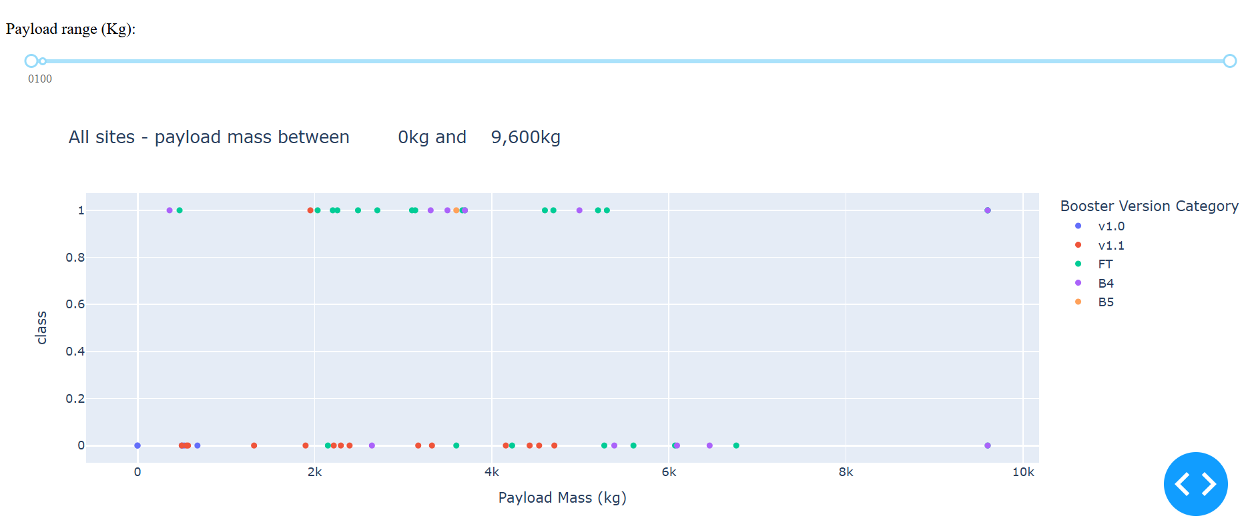
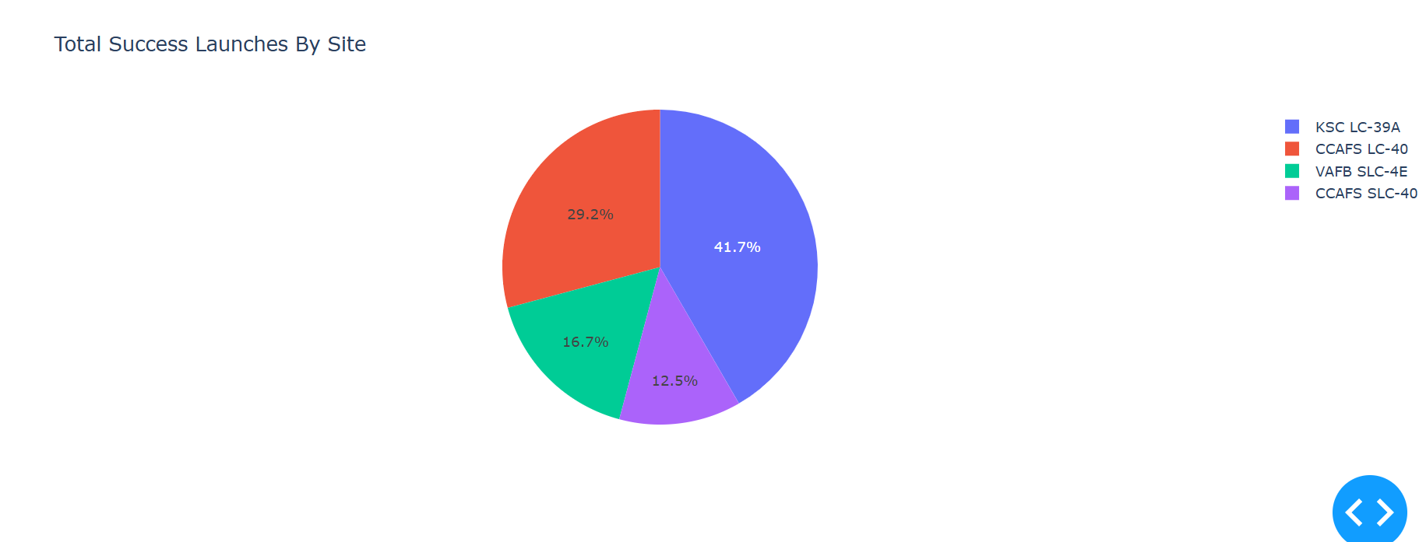
Build a Dashboard with Plotly Dash
Launch Sites Dropdown List:
Added a dropdown list to enable Launch Site selection.
Pie Chart showing Success Launches (All Sites/Certain Site):
Added a pie chart to show the total successful launches count for all sites and the Success vs. Failed counts for the site, if a specific Launch Site was selected.
Slider of Payload Mass Range:
Added a slider to select Payload range.
Scatter Chart of Payload Mass vs. Success Rate for the different Booster Versions:
Added a scatter chart to show the correlation between Payload and Launch Success.
GitHub URL: https://github.com/yash2412-d/IBM-Data-Science/blob/main/Applied%20Data%20Science%20Capstone/Week%203/spacex_dash_app.py

Slide 15
Predictive Analysis (Classification)
Building the Model
Load the dataset into
NumPy and Pandas
Transform the data and then split into training and test datasets
Decide which type of ML to use
Set the parameters and algorithms to GridSearchCV and fit it to dataset.
2. Evaluating the Model
Check the accuracy for each model
Get tuned hyperparameters for each type of algorithms
Plot the confusion matrix.
3. Improving the Model
Use Feature Engineering and Algorithm Tuning
4. Find the Best Model
The model with the best accuracy score will be the best performing model.
GitHub URL: https://github.com/yash2412-d/IBM-Data-Science/blob/main/Applied%20Data%20Science%20Capstone/Week%204/SpaceX_Machine%20Learning%20Prediction_Part_5%20(1).ipynb

Slide 16
Results
Exploratory data analysis results
Interactive analytics demo in screenshots
Predictive analysis results

Slide 17

Section 2

Slide 18
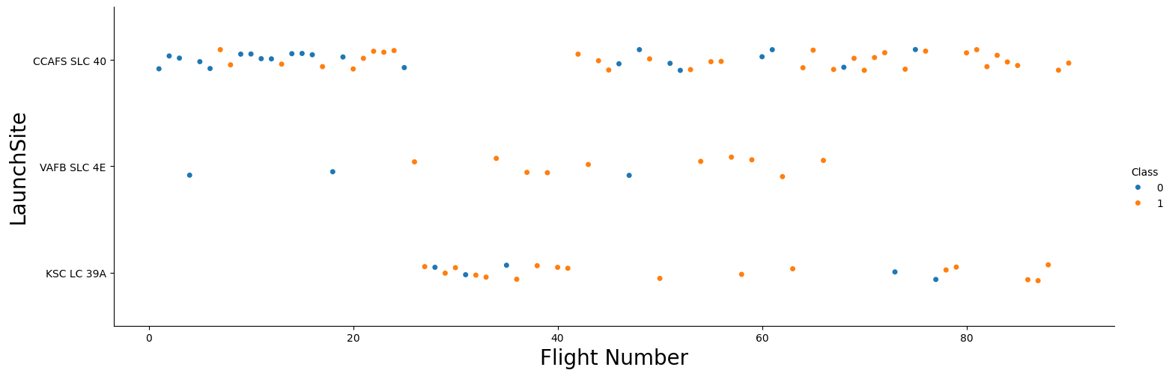
Flight Number vs. Launch Site
Explanation:
• The earliest flights all failed while the latest flights all succeeded.
• The CCAFS SLC 40 launch site has about a half of all launches.
• VAFB SLC 4E and KSC LC 39A have higher success rates.
• It can be assumed that each new launch has a higher rate of success.

Slide 19
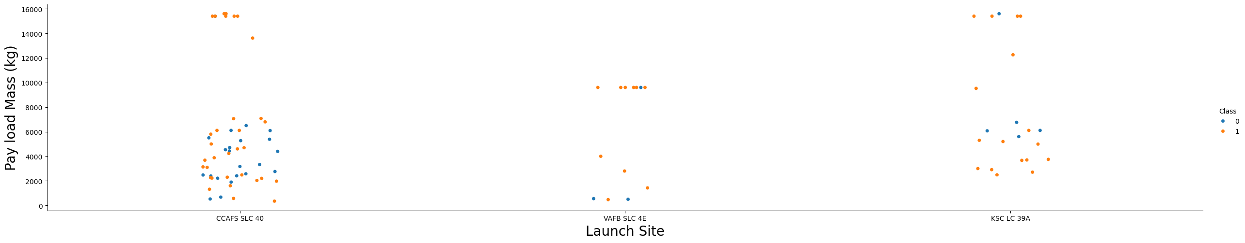
Payload vs. Launch Site
Explanation:
• For every launch site the higher the payload mass, the higher the success rate.
• Most of the launches with payload mass over 7000 kg were successful.
• KSC LC 39A has a 100% success rate for payload mass under 5500 kg too.

Slide 20
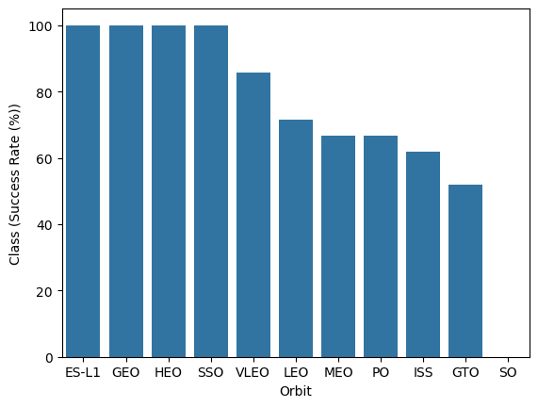
Success Rate vs. Orbit Type
Explanation:
Orbits with 100% success rate:
ES-L1, GEO, HEO, SSO
Orbits with 0% success rate:
SO
Orbits with success rate between 50% and 85%:
GTO, ISS, LEO, MEO, PO

Slide 21

Flight Number vs. Orbit Type
Explanation:
• In the LEO orbit the Success appears related to the number of flights; on the other hand, there seems to be no relationship between flight number when in GTO orbit.

Slide 22
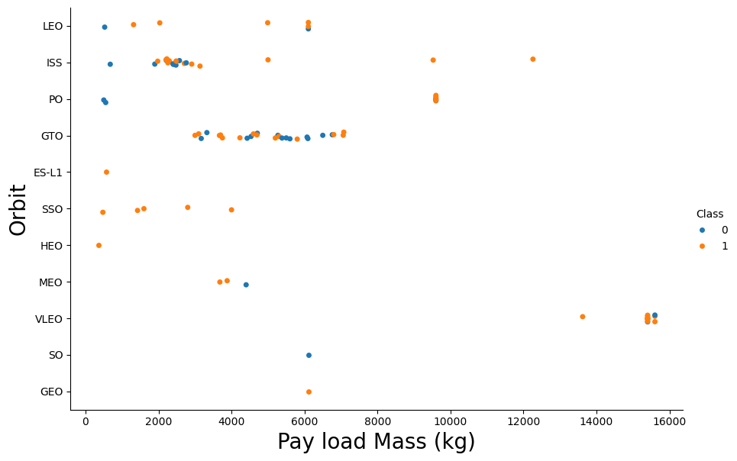
Payload vs. Orbit Type
Explanation:
• Heavy payloads have a negative influence on GTO orbits and positive on GTO and Polar LEO (ISS) orbits.

Slide 23
Launch Success Yearly Trend
Explanation:
• The success rate since 2013 kept increasing till 2020.

Slide 24
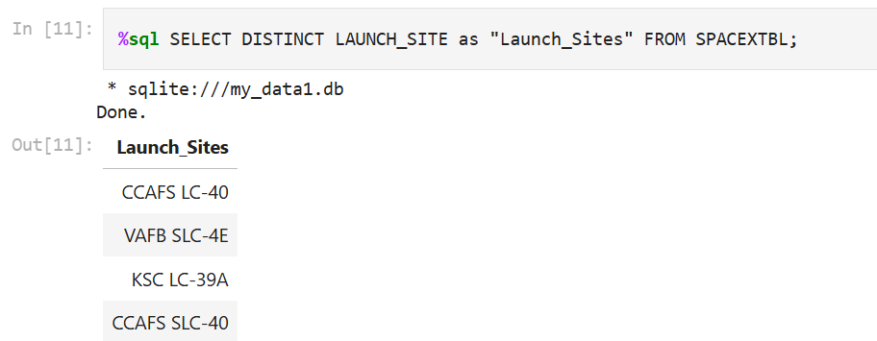
All Launch Site Names
Explanation:
• Displaying the names of the unique launch sites in the space mission.

Slide 25
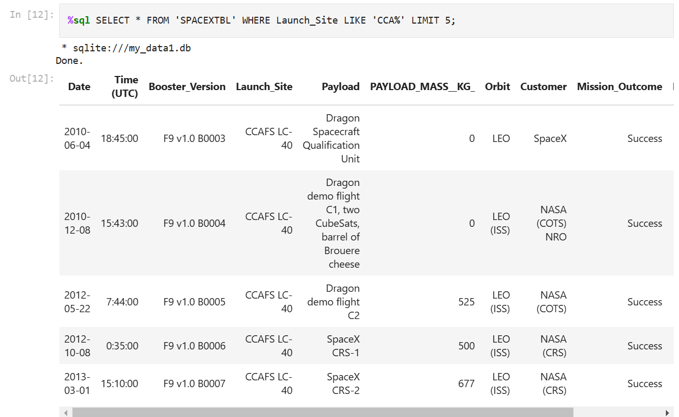
Launch Site Names Begin with 'CCA'
Explanation:
• Displaying 5 records where launch sites begin with the string 'CCA'.

Slide 26
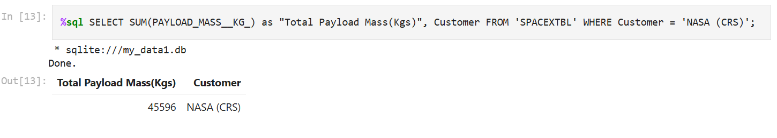
Total Payload Mass
Explanation:
• Displaying the total payload mass carried by boosters launched by NASA (CRS).

Slide 27
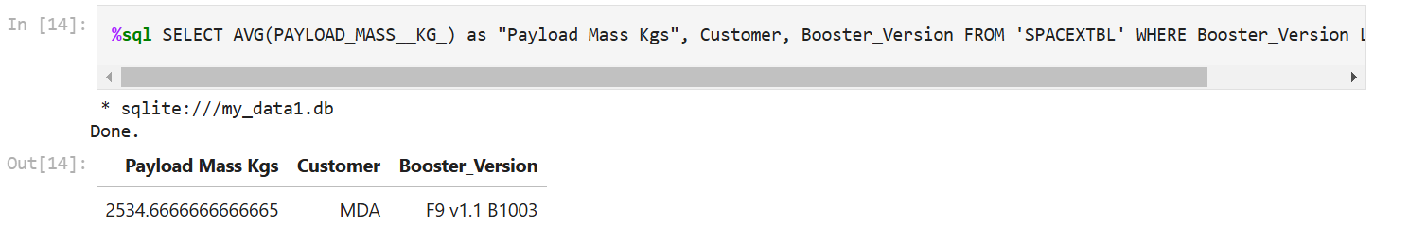
Average Payload Mass by F9 v1.1
Query:
%sql SELECT AVG(PAYLOAD_MASS__KG_) as "Payload Mass Kgs", Customer, Booster_Version FROM 'SPACEXTBL' WHERE Booster_Version LIKE 'F9 v1.1%';
Explanation:
• Displaying average payload mass carried by booster version F9 v1.1.

Slide 28
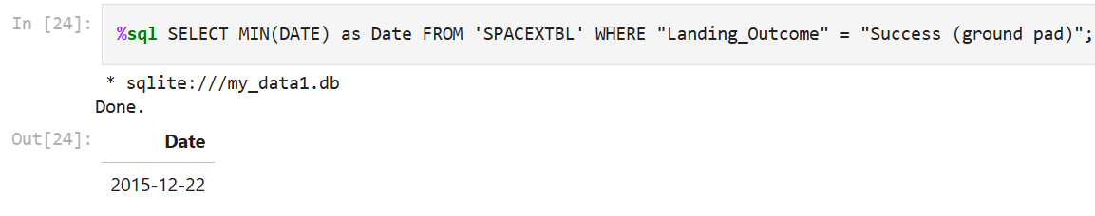
First Successful Ground Landing Date
Explanation:
• Listing the date when the first successful landing outcome in ground pad was achieved.

Slide 29
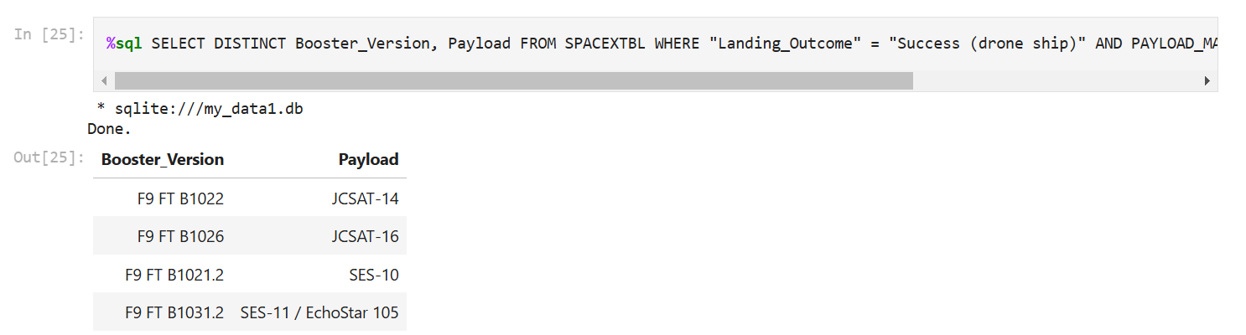
Successful Drone Ship Landing with Payload between 4000 and 6000
Query:
%sql SELECT DISTINCT Booster_Version, Payload FROM SPACEXTBL WHERE "Landing_Outcome" = "Success (drone ship)" AND PAYLOAD_MASS__KG_ > 4000 AND PAYLOAD_MASS__KG_ < 6000;
Explanation:
• Listing the names of the boosters which have success in drone ship and have payload mass greater than 4000 but less than 6000.

Slide 30
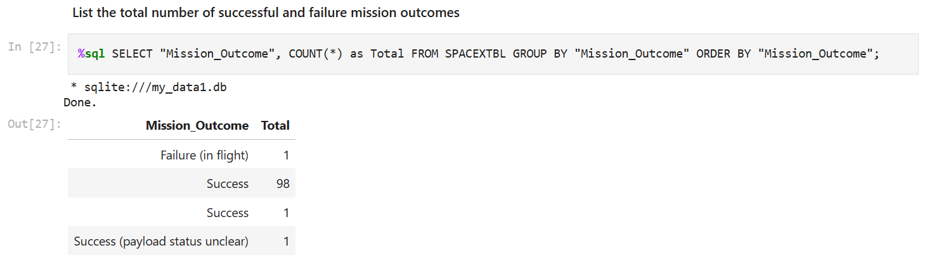
Total Number of Successful and Failure Mission Outcomes
Explanation:
• Listing the total number of successful and failure mission outcomes.

Slide 31
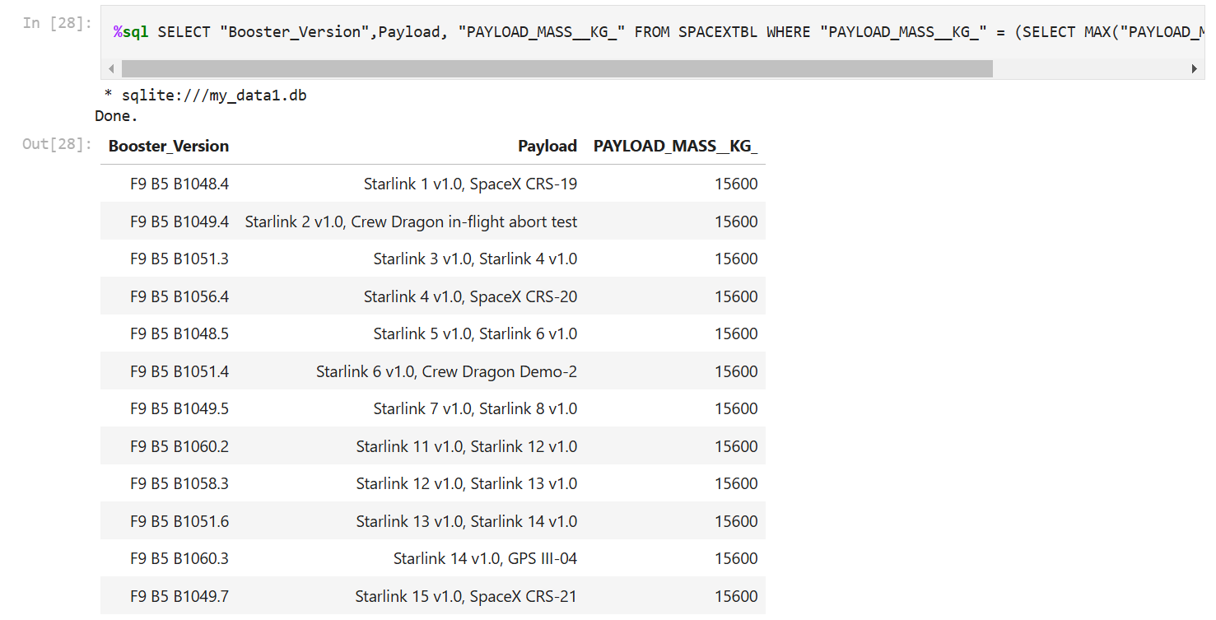
Boosters Carried Maximum Payload
Query:
%sql SELECT "Booster_Version",Payload, "PAYLOAD_MASS__KG_" FROM SPACEXTBL WHERE "PAYLOAD_MASS__KG_" = (SELECT MAX("PAYLOAD_MASS__KG_") FROM SPACEXTBL);
Explanation:
• Listing the names of the booster versions which have carried the maximum
payload mass.

Slide 32
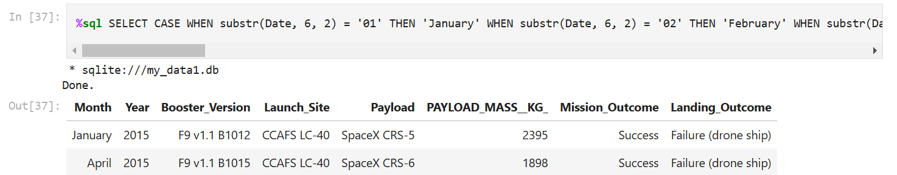
2015 Launch Records
Query:
%sql SELECT CASE WHEN substr(Date, 6, 2) = '01' THEN 'January' WHEN substr(Date, 6, 2) = '02' THEN 'February' WHEN substr(Date, 6, 2) = '03' THEN 'March' WHEN substr(Date, 6, 2) = '04' THEN 'April' WHEN substr(Date, 6, 2) = '05' THEN 'May' WHEN substr(Date, 6, 2) = '06' THEN 'June' WHEN substr(Date, 6, 2) = '07' THEN 'July' WHEN substr(Date, 6, 2) = '08' THEN 'August' WHEN substr(Date, 6, 2) = '09' THEN 'September' WHEN substr(Date, 6, 2) = '10' THEN 'October' WHEN substr(Date, 6, 2) = '11' THEN 'November' WHEN substr(Date, 6, 2) = '12' THEN 'December' END AS Month, substr(Date, 1, 4) AS Year, "Booster_Version", "Launch_Site", Payload, "PAYLOAD_MASS__KG_", "Mission_Outcome", "Landing_Outcome" FROM SPACEXTBL WHERE substr(Date, 1, 4) = '2015' AND "Landing_Outcome" = 'Failure (drone ship)';
Explanation:
• Listing the failed landing outcomes in drone ship, their booster versions and launch site names for the months in year 2015.

Slide 33
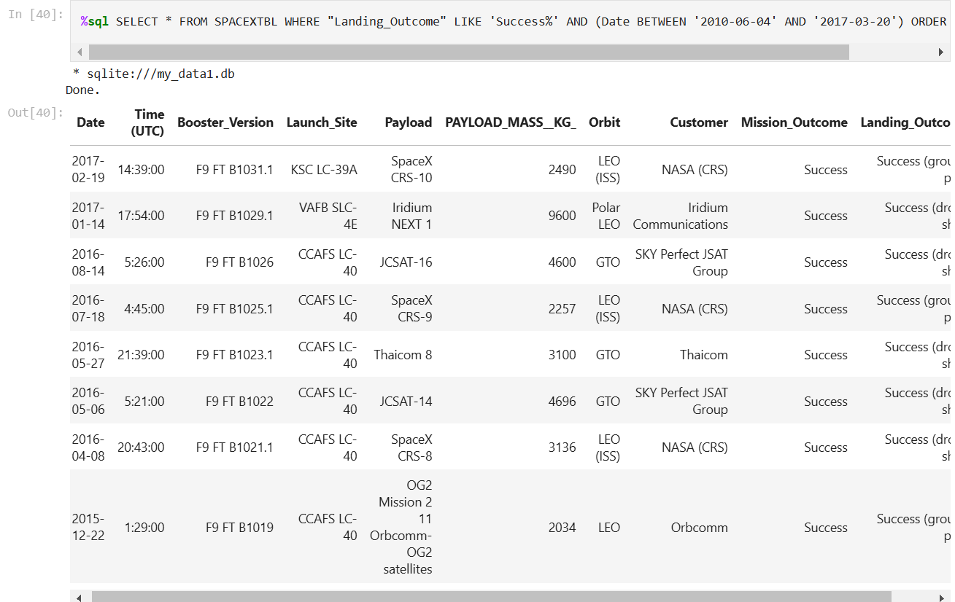
Rank Landing Outcomes Between 2010-06-04 and 2017-03-20
Query:
%sql SELECT * FROM SPACEXTBL WHERE "Landing_Outcome" LIKE 'Success%' AND (Date BETWEEN '2010-06-04' AND '2017-03-20') ORDER BY Date DESC;
Explanation:
• Ranking the count of landing outcomes (such as Failure (drone ship) or Success (ground pad)) between the date 2010-06-04 and 2017-03-20 in descending order.

Slide 34

Section 3

Slide 35
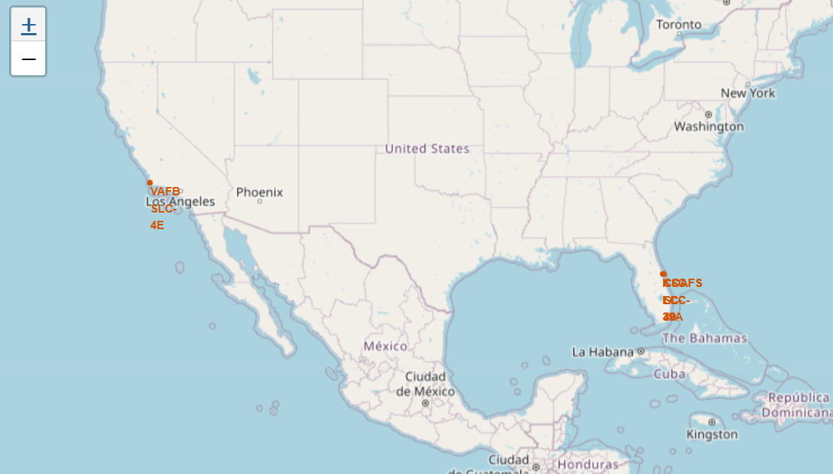
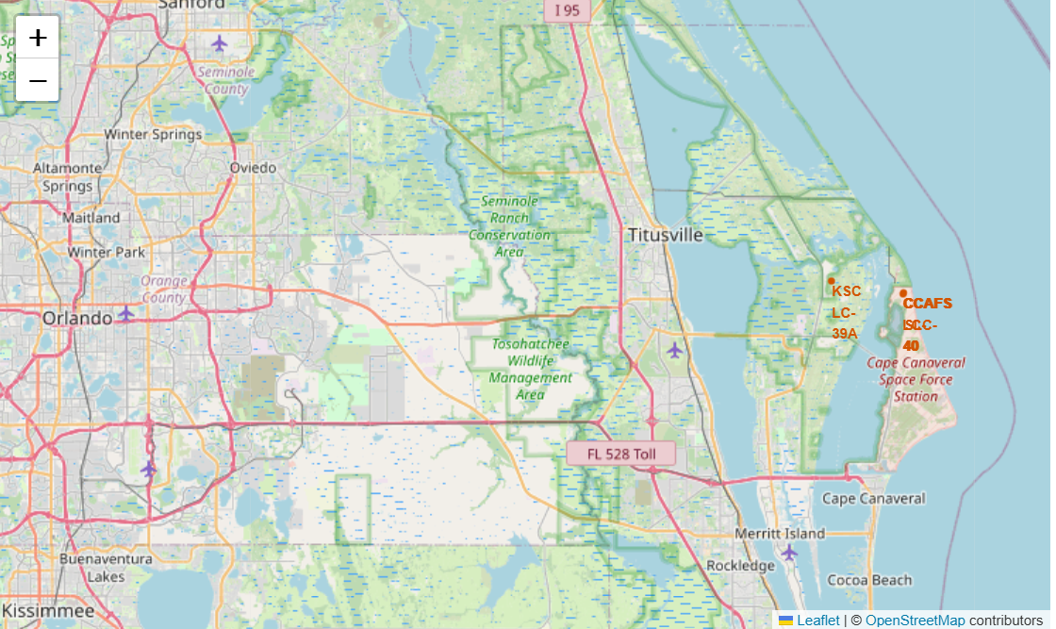
Launch Site Locations
The left map shows all launch sites relative US map. The right map shows the two Florida launch sites since they are very close to each other. All launch sites are near the ocean.

Slide 36
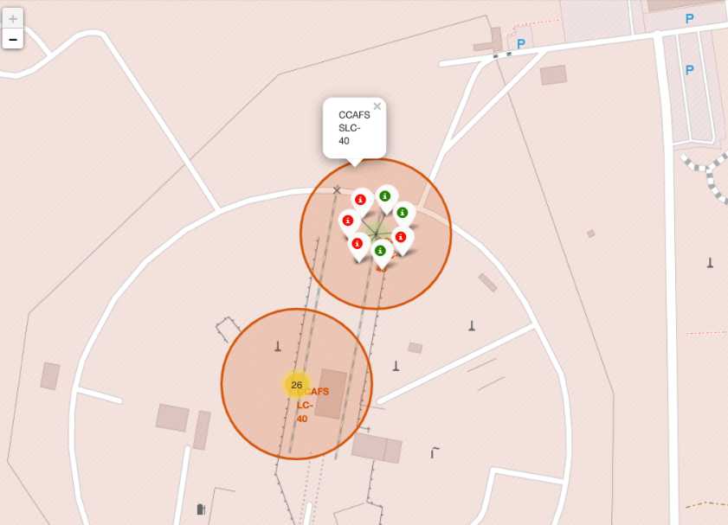
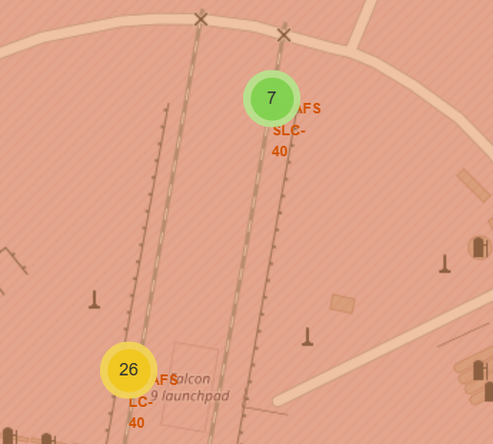
Color-Coded Launch Markers
Explanation:
From the colour-labeled markers we should be able to easily identify which launch sites have relatively high success rates.
Green Marker = Successful Launch
Red Marker = Failed Launch
Launch Site KSC LC-39A has a very high Success Rate.

Slide 37
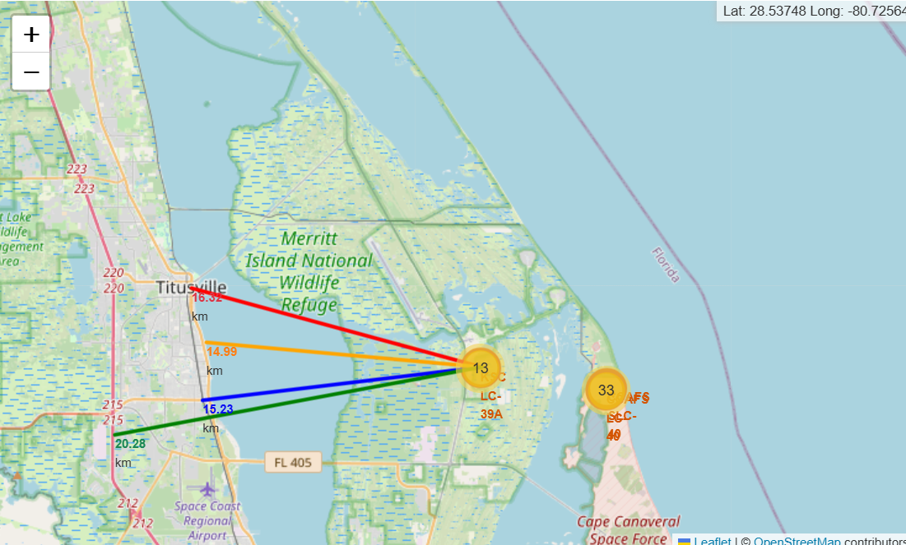
Distance from the launch site KSC LC-39A to its proximities
Using KSC LC-39A as an example, launch sites are very close to railways for large part and supply transportation. Launch sites are close to highways for human and supply transport. Launch sites are also close to coasts and relatively far from cities so that launch failures can land in the sea to avoid rockets falling on densely populated areas.

Slide 38

Section 4

Slide 39
Launch success count for all sites
The chart clearly shows that from all the sites, KSC LC-39A has the most successful launches.

Slide 40
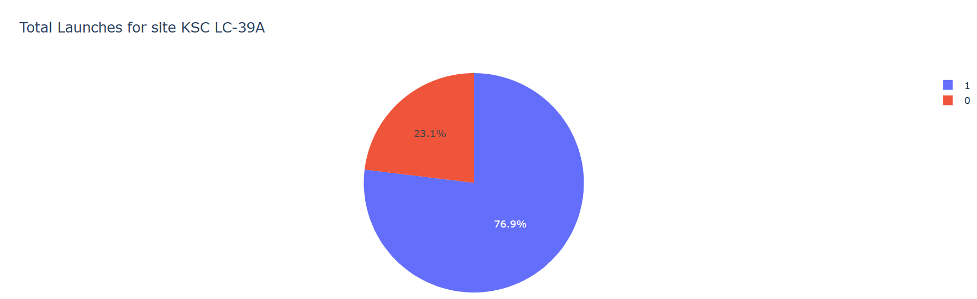
Launch site with highest launch success ratio
KSC LC-39A has the highest launch success rate (76.9%) with 10 successful and only 3 failed landings.

Slide 41
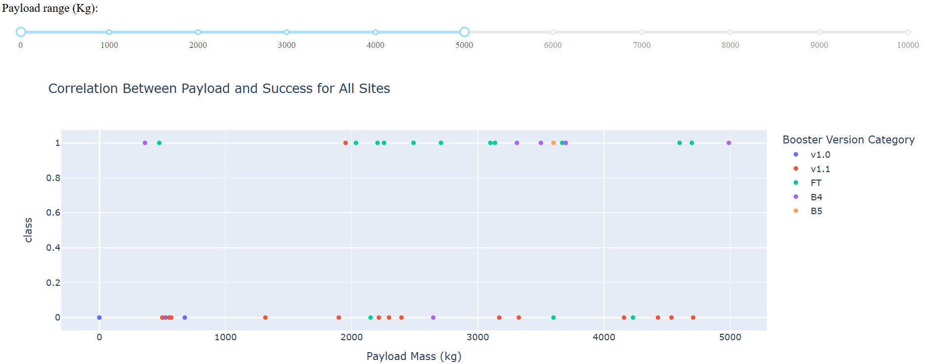
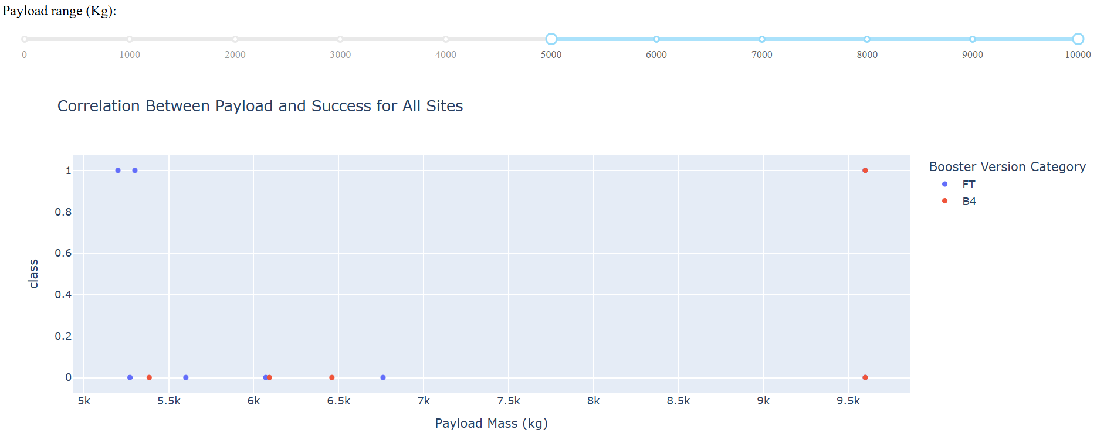
Payload Mass vs. Launch Outcome for all sites
The charts show that payloads between 2000 and 5500 kg have the highest success rate.

Slide 42

Section 5

Slide 43
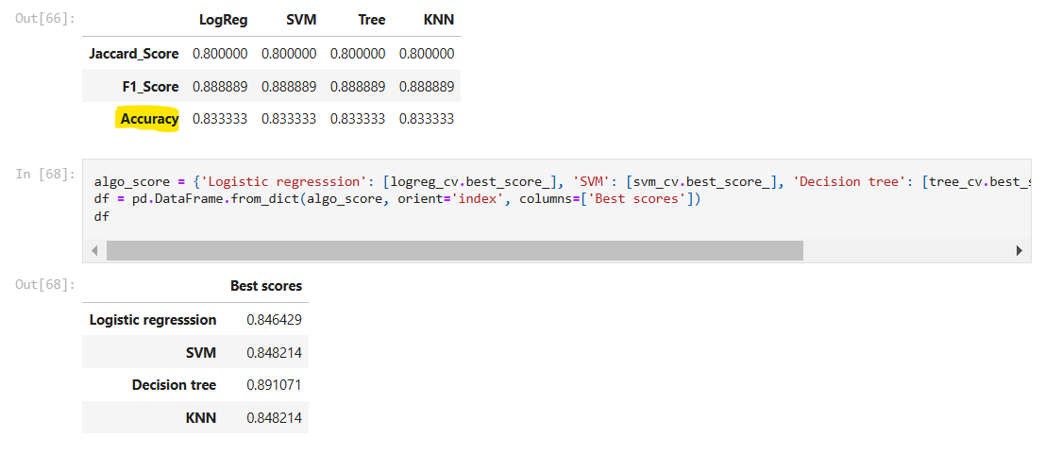
Classification Accuracy
Accuracy of all the models is same. Since they are all same we picked best scores. So, based on their best scores Decision Tree is best model.

Slide 44
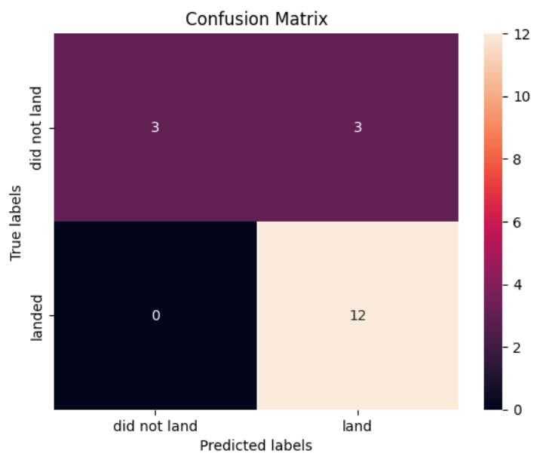
Confusion Matrix
Since all models performed the same for the test set, the confusion matrix is the same across all models. The models predicted 12 successful landings when the true label was successful landing.
The models predicted 3 unsuccessful landings when the true label was unsuccessful landing.
The models predicted 3 successful landings when the true label was unsuccessful landings (false positives). Our models over predict successful landings.

Slide 45
Conclusions
We can conclude that:
The larger the flight amount at a launch site, the greater the success rate at a launch site.
Launch success rate started to increase in 2013 till 2020.
Orbits ES-L1, GEO, HEO, SSO, VLEO had the most success rate.
KSC LC-39A had the most successful launches of any sites.
The Decision tree classifier is the best machine learning algorithm for this task.

Slide 46


